Slide 1
US Flight Delay Dashboard by Yosua Turnip
File created on: 3/7/2023 6:31:40 AM

Slide 3
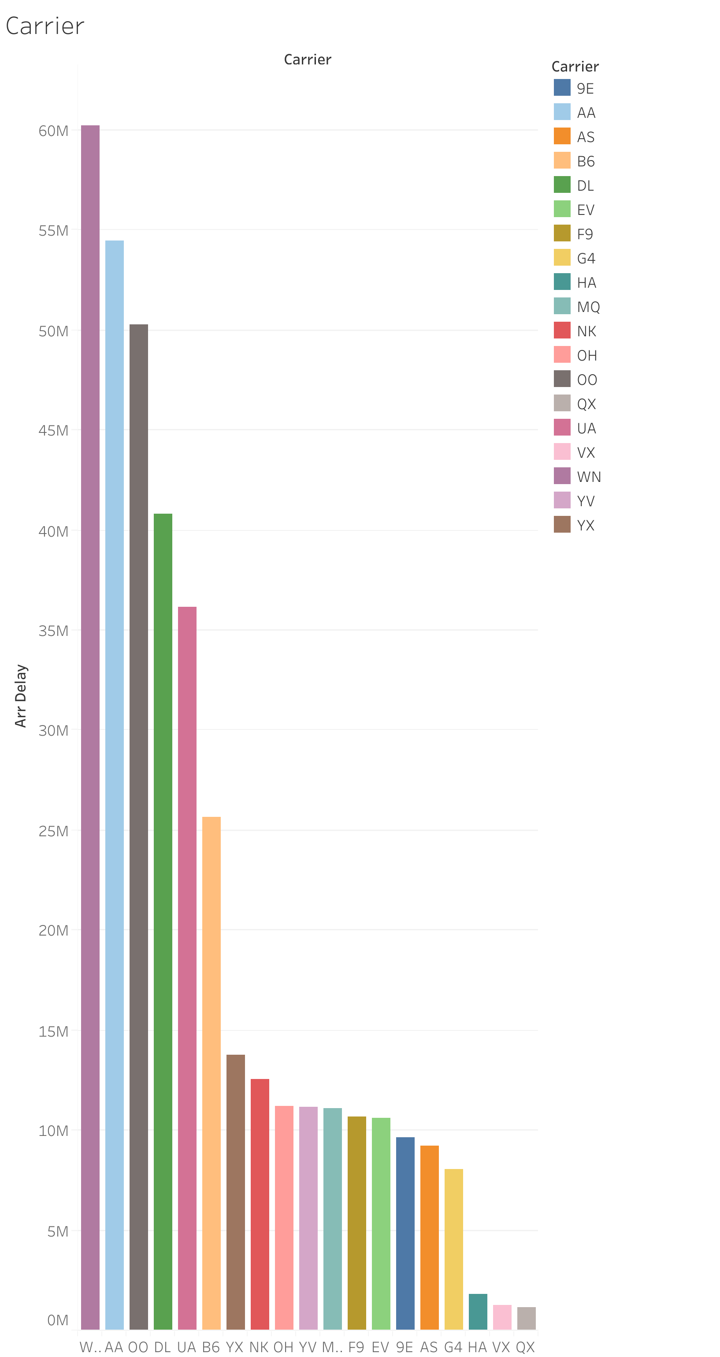

Slide 4
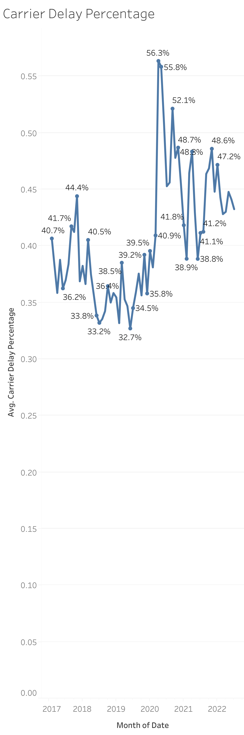

Slide 5
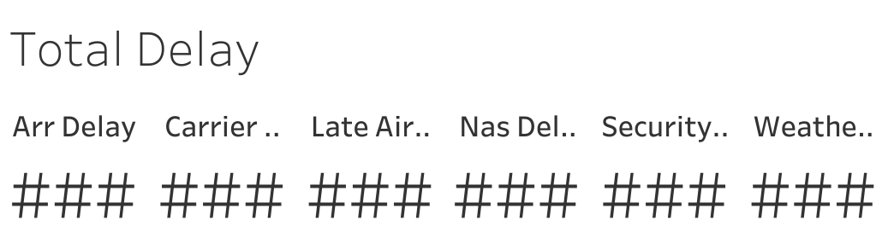

Slide 6
